Slide 1
Tutorial 4: Decision Trees
COMP 4331
TA: Vincent Cheng
yzhengbs@connect.ust.hk
HKUST

Slide 2
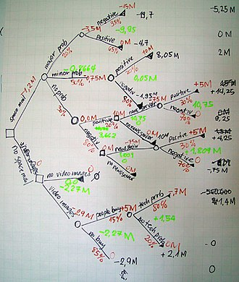
Decision Trees
A non-parametric supervised learning method
Can be used for classification
Goal: Create a model that predicts the value of a target variable by learning simple decision rules inferred from the data features

Slide 3
DecisionTreeClassifier
The scikit-learn already have a Decision Tree class implemented for us, which is DecisionTreeClassifier. We don’t have to implement Decision Tree again.
According to students' feedback, remember to open the desired conda environment before installing packages:
open terminal
type in conda activate comp4331 (activate your conda environment)
type in conda install -c conda-forge scikit-learn (install scikit-learn)

Slide 4
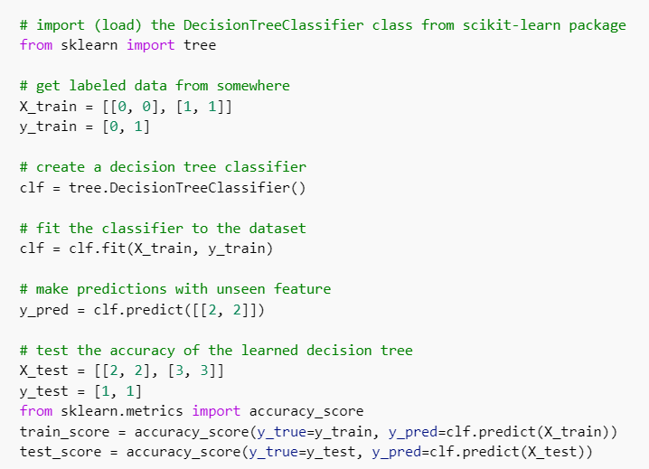
minimal working example
Import Decision Tree class
Get data
Initialize Decision Tree
Train Decision Tree
Do classification with trained decision tree
Evaluate decision tree on test dataset

Slide 5
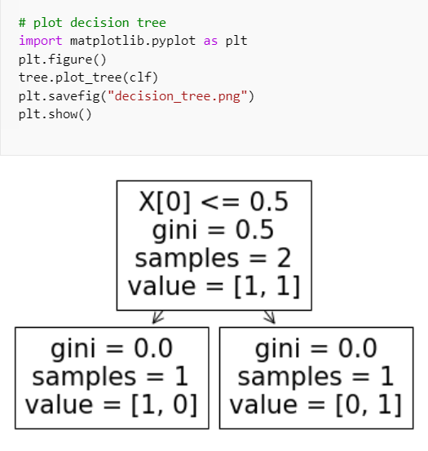
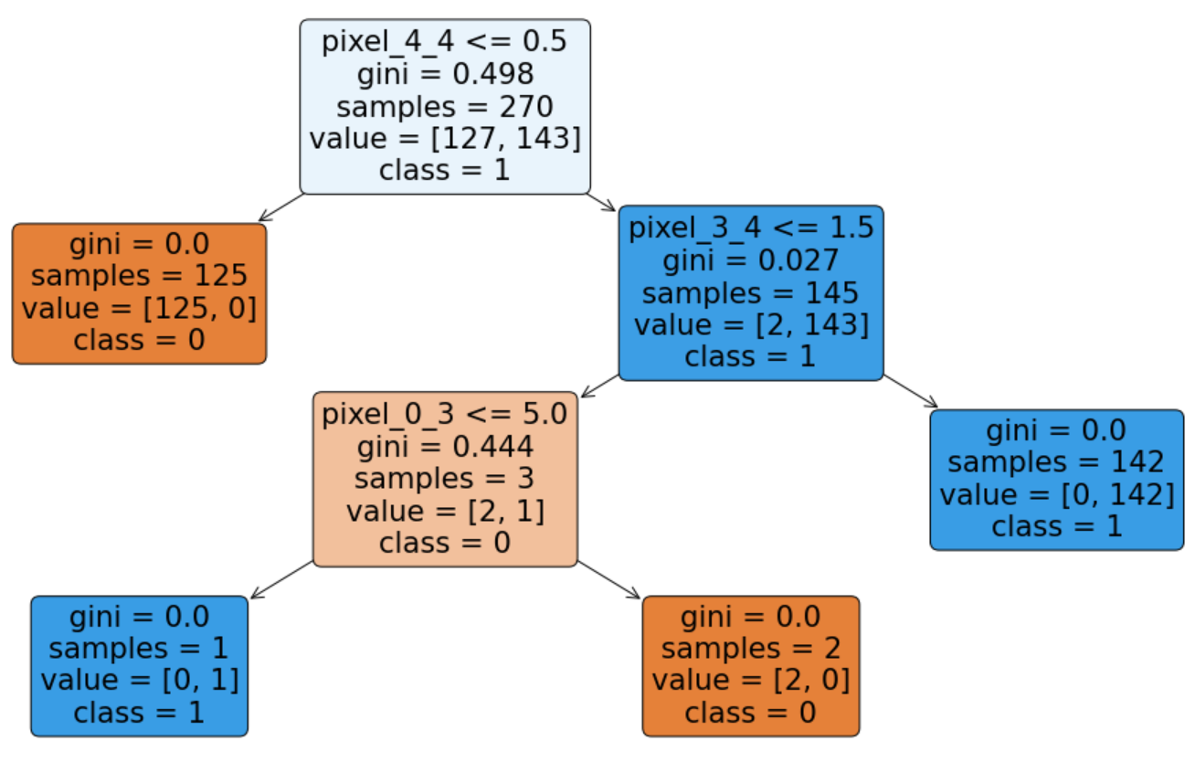
Visualize Decision Tree
After we train a Decision Tree, we can visualize it to see the result using plot_tree function.
Supplying feature_names, class_names, filled, etc
to plot_tree will result in a much informative plot
to save figure as a file, run plt.savefig(“filename.png”)
before plt.show()

Slide 6
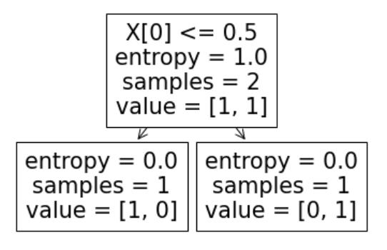
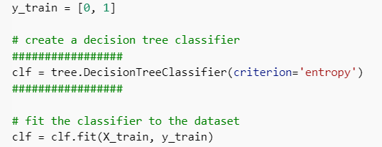
Compare attribute selection measures
DecisionTreeClassifier(criterion='gini', splitter='best', max_depth=None,
min_samples_split=2, min_samples_leaf=1, min_weight_fraction_leaf=0.0,
max_features=None, random_state=None, max_leaf_nodes=None, min_impurity_decrease=0.0, class_weight=None, ccp_alpha=0.0)
Here is the default settings for DecisionTreeClassifier. By default, it uses Gini index/impurity.
To use information gain as selection measure, specify criterion=‘entropy’ when initializing the Decision Tree class.

Slide 7
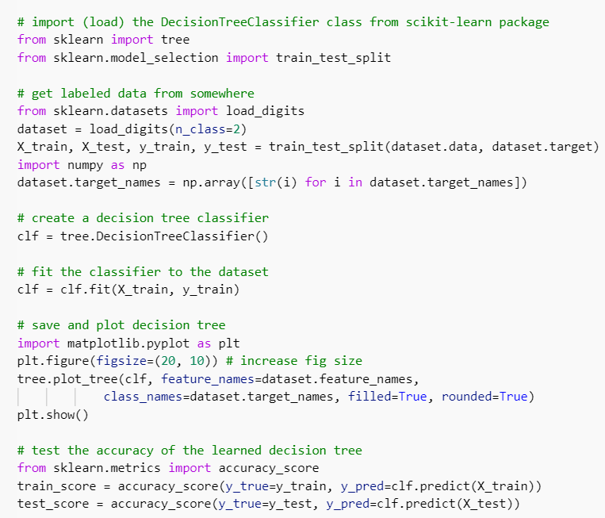
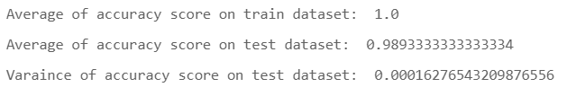
Compare attribute selection measures
Previous dataset is too simple. Scikit-learn comes with a few datasets which is handy for demo.
Let’s train a new Decision Tree with the builtin handwritten digit dataset from scikit-learn.
After repeating the whole process 50 times:

Slide 8
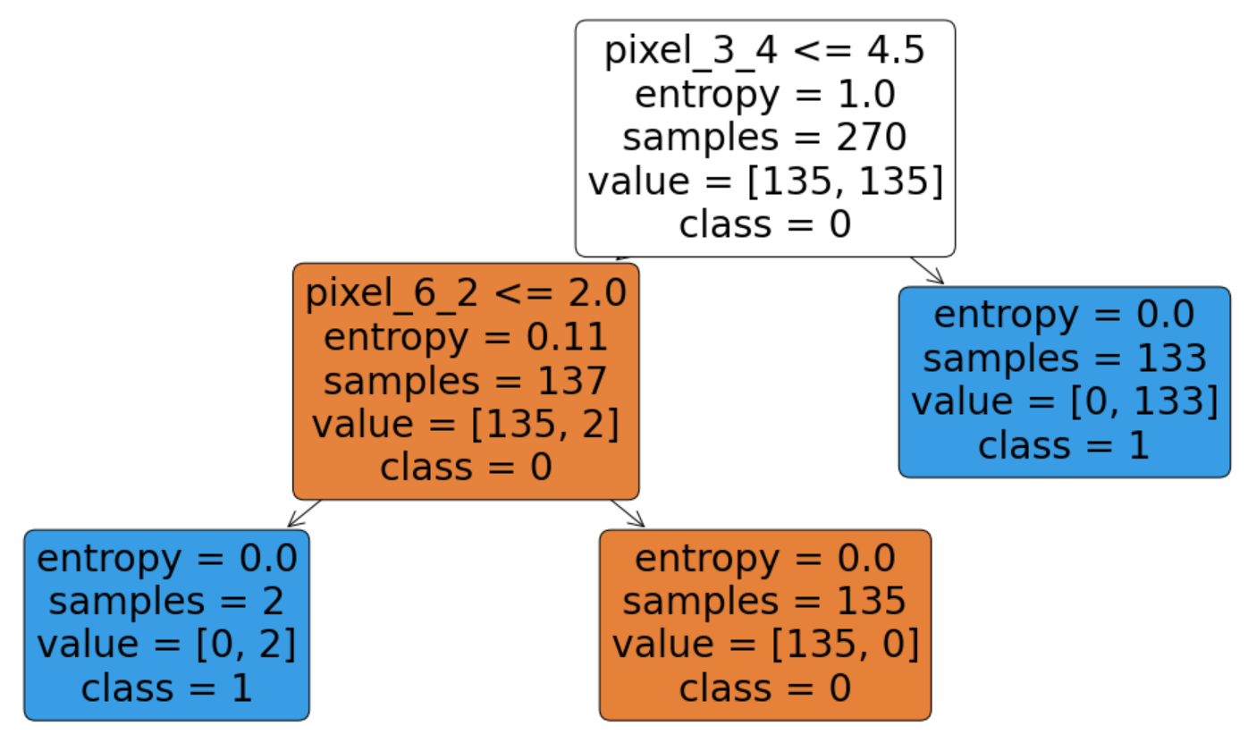

Compare attribute selection measures
Previous example used gini index as selection measures.
Here we try criterion=“entropy” (information gain) for comparison.
After repeating the whole process 50 times:

Slide 9
Tackling Overfitting – Early-stopping
Default settings might lead to overfitting. We can specify parameters to achieve early-stopping.
With default setting, we get the following tree by training with data from make_classification.
clf = tree.DecisionTreeClassifier()
Default settings:
Accuracy score on train dataset: 1.0
Accuracy score on test dataset: 0.76
(double-click image to view detail)

Slide 10
Tackling Overfitting – Early-stopping
max_depth limits the maximum depth of the tree. Deeper tree captures more information about the data,
but might lead to overfitting the data. The following tree uses max_depth=4.
clf = tree.DecisionTreeClassifier(max_depth=4)
Default settings:
Accuracy score on train dataset: 1.0
Accuracy score on test dataset: 0.76
max_depth=4:
Accuracy score on train dataset: 0.888
Accuracy score on test dataset: 0.896

Slide 11
Tackling Overfitting – Early-stopping
min_samples_split limits the minimum number of samples required to split an internal node.
Increase value to stop early. Overly large value will prevent the tree from learning the data.
The following tree uses min_samples_split=10.
clf = tree.DecisionTreeClassifier(min_samples_split=10)
Default settings:
Accuracy score on train dataset: 1.0
Accuracy score on test dataset: 0.76
max_depth=4:
Accuracy score on train dataset: 0.888
Accuracy score on test dataset: 0.896
min_samples_split=10:
Accuracy score on train dataset: 0.981333
Accuracy score on test dataset: 0.824

Slide 12
Tackling Overfitting – Early-stopping
min_samples_leaf limits the minimum number of samples required to be at a leaf node.
Increase value to stop early. Unlike min_samples_split, this guarantees that each leaf has a minimum size.
The following tree uses min_samples_leaf=5.
clf = tree.DecisionTreeClassifier(min_samples_leaf=5)
Default settings:
Accuracy score on train dataset: 1.0
Accuracy score on test dataset: 0.76
max_depth=4:
Accuracy score on train dataset: 0.888
Accuracy score on test dataset: 0.896
min_samples_split=10:
Accuracy score on train dataset: 0.981333
Accuracy score on test dataset: 0.824
min_samples_leaf=5:
Accuracy score on train dataset: 0.936
Accuracy score on test dataset: 0.872

Slide 13
Tackling Overfitting – Pruning
Pruning also can generate compact and good result.
clf = tree.DecisionTreeClassifier(ccp_alpha=0.015)
Default settings:
Accuracy score on train dataset: 1.0
Accuracy score on test dataset: 0.76
max_depth=4:
Accuracy score on train dataset: 0.888
Accuracy score on test dataset: 0.896
min_samples_split=10:
Accuracy score on train dataset: 0.981333
Accuracy score on test dataset: 0.824
min_samples_leaf=5:
Accuracy score on train dataset: 0.936
Accuracy score on test dataset: 0.872
ccp_alpha=0.015:
Accuracy score on train dataset: 0.8667
Accuracy score on test dataset: 0.896

Slide 14
Code for this tutorial
You can find code for this tutorial at
https://colab.research.google.com/drive/1AazK30rk1cxvaFDK6zaRBcn-nYzkpGW8?usp=sharing
The jupyter notebook version is also attached here:

Slide 15
Tutorial 4: Part 2
JIANG Weisen
wjiangar@connect.ust.hk
HKUST
2021 Oct. 8

Slide 16
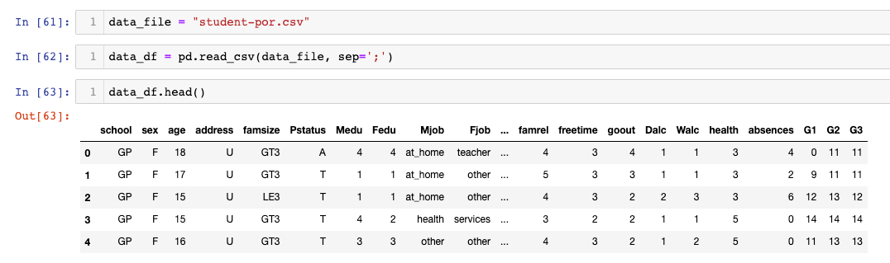
Original data

Slide 17
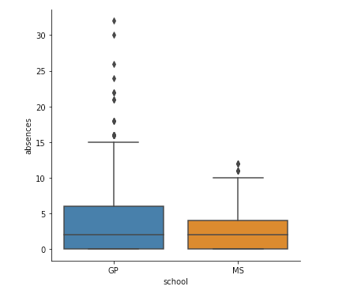
BoxPlot
Boxplots of “absences” for various schools.

Slide 18
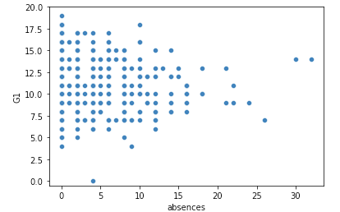
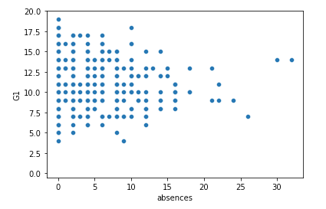
ScatterPlot
For “G1”, replace missing values with the median value

Slide 19
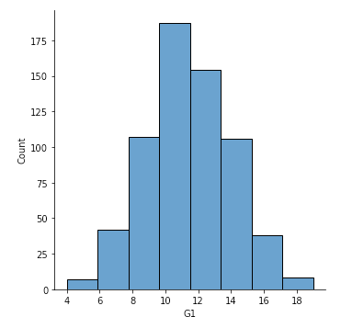
Histogram
Histogram of “G1”

Slide 20
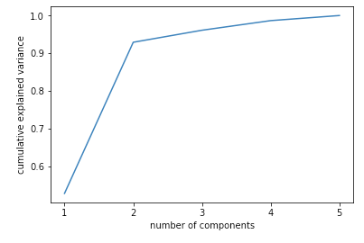
PCA: plot the cumulative explained variance
For attributes: "G1", "G2", "G3", "age", "absences”.

Slide 21
Q&A

